Slide 1

Events
That’s what’s happenin’!

Slide 2

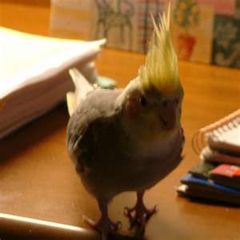
What we are gonna’ do
Masterpiece Theatre-Highlighted Code
Talk about OOP
Talk about events in .NET
Talk about Chris’ Online Application event model
We will talk about the bird in the last slide
What am I doing here ?

Slide 3
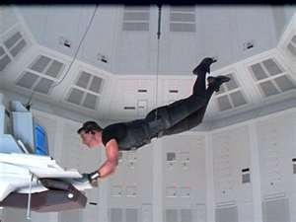
Mission Impossible
Problem: I want to find a control on a page but intellisence can’t find it
Examples
On Page, Control is on MasterPage
On UserControl, Control is on Parent page or Master Page
On Page, control is on usercontrol
How come it doesn’t show up?

Slide 4
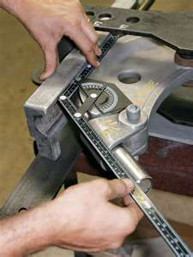
Possible Solutions
Use FindControl to find the item
Problem is need to use hierarchy to find it
Therefore closely coupled code
The closely coupled code can make it blow up if you change the structure of the page

Slide 5

Master Solution
EMSG.ApplicationBlocks.ControlMethods.GetControlFromControlID(System.Web.UI.Page, string)
If you are using WebAuth you have it already!
Method is not static but just need to create object
Remember you will need to cast the object when you get it back
As loosely coupled you can get under the circumstances

Slide 6
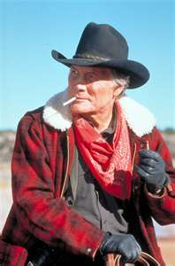
Another Good Solution
If you are looking for a particular type of object and there is only 1 type on the page
Do a loop and return that special object
Ok solution if a 1of a kind item like a menu
The id is now NOT closely coupled
if (radAjaxPanelChild is RadPanelBar)
{RadPanelBar rp1 = (RadPanelBar) radAjaxPanelChild;}
I just need one thing

Slide 7
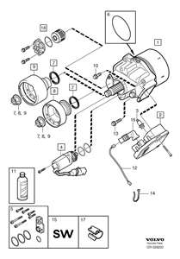
A quick word on..…
Coupling or dependencies
You don’t want it to be close
You want your code to be selfish
Code should only care about itself and its friends
We should be able to change things in page and not affect things you didn’t change
The trick is you have to predict how it will change

Slide 8
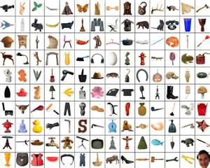

Now a little review
Object Oriented Programming
Map things in the world to code
Types of Things are classes (nouns)
Functions are verbs(things the nouns do)
Adjectives are properties(things that describe the noun)
Events are well….events(moments when state changes for the noun)

Slide 9

Dan in Real Life
Dan is a person
Person is the class
Dan is the instance

Slide 10

Dan’s issues
Dan doesn’t have math skills
MathAbility=false;
Dan buys a lottery ticket which is a verb(function)
BuyingATicket()
When Dan buys a ticket an event happens
TicketBought happens after BuyingATicket is complete
There could be other events

Slide 11
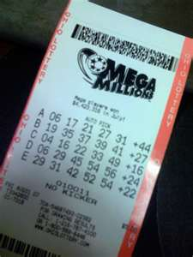
Let’s fix Dan
StartingToBuyTicket would be a good event
When Dan is starting to buy a ticket we can set Money=0 to stop the process
Events let us react when things happen to modify them or prevent them or call a method like DontWasteYourMoney

Slide 12
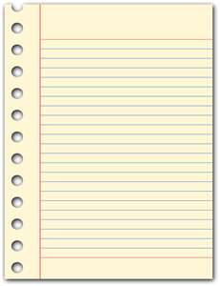
Paging events
What happens in a page?
http://msdn.microsoft.com/en-us/library/ms178472.aspx
Init
InitComplete
PreLoad
Load →We always react to this!
Control Events
LoadComplete
PreRender
PreRenderComplete
SaveStateComplete
Render
Unload

Slide 13
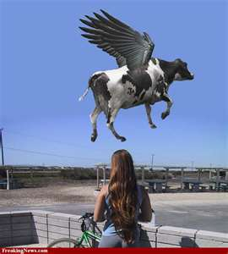
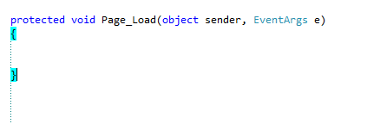
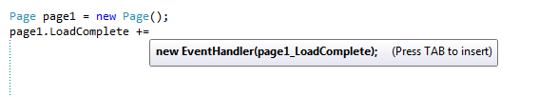
React
You can react to events-EventHandlers
Notice the signature of Load
Thing that changed
The event data
Visual Studio will auto generate your function

Slide 14

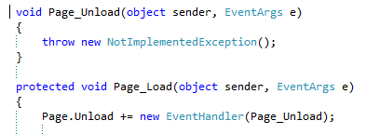
What happens
Note that the new EventHandler sends the function name
The function always has a object,event structure
Can create custom EventArgs deriving from EventArgs

Slide 15
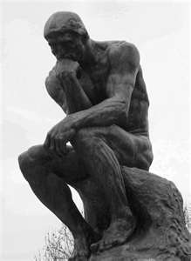
Think about…
EventHandlers point at a function
We didn’t need to pass 2 objects even though that is the signature of the function that it points at
We used the += notation
So we now know how to react

Slide 16
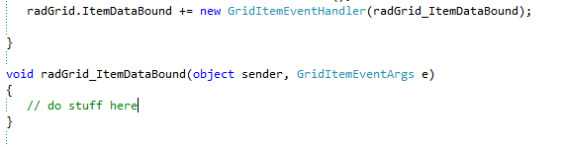
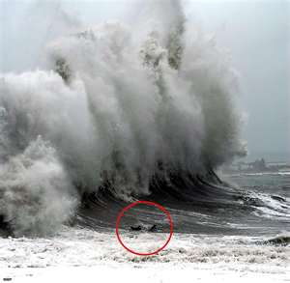
Other objects…
RadGrid
Let’s say you want to massage some data you get back from the db
You can modify when it is bound
Note the custom eventarg
There is a client side event structure also for most Telerik controls
That is really RAD

Slide 17

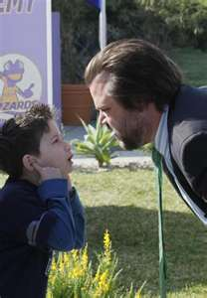
Listen
In ASPX pages, EventHandlers listen for events to happen
Then they send them to any function that you have declared
JavaScript has event model too
Should ALWAYS manipulate objects only after Page_Load
In JavaScript, usually called eventlisteners
I can’t hear you!

Slide 18
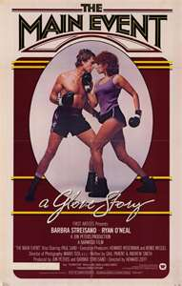
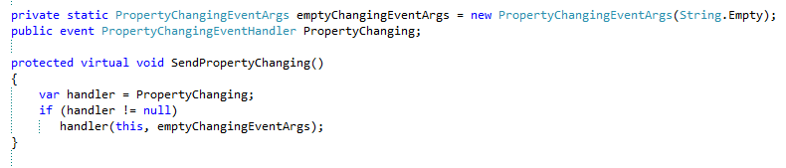
How do we create events?
SubSonic autocreated events
Classes.cs
Creates a custom event argument
PropertyChangingEventArgs
From System.Component
Create an event
Create a function for the event
If not null say event happened
Note virtual void

Slide 19
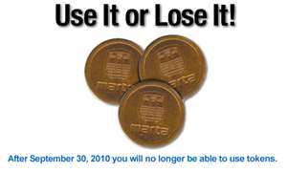
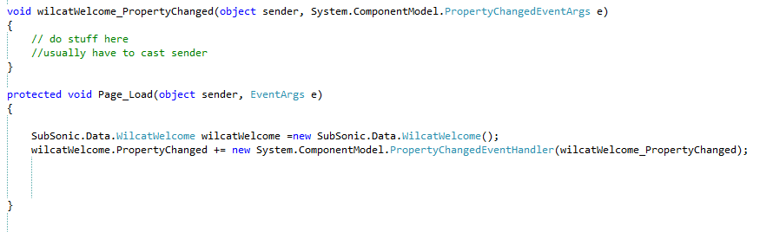
Now use it
Get property from intellisense then += Tab, Tab
You usually have to cast the sender object
Now I can react to wildcatWelcome changes

Slide 20
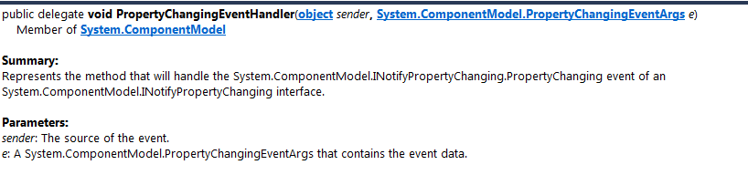
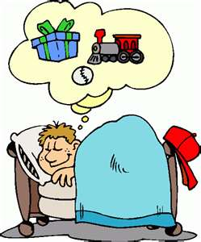
What if…
It is a new event that doesn’t already exist?
You create a delegate
PropertyChangingEventHandler is a delegate

Slide 21
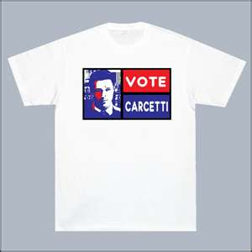
Delegates are easy
public delegate void ChangedEventHandler(object sender, EventArgs e);
You are just basically giving a new name with an event signature
It is very weird-I agree
Don’t think too hard on this-you will go over the abyss

Slide 22

From scratch…
Create delegate
public delegate void SomethingDumbOccurs(object sender, EventArg event)
Create event
public event SomethingDumbOccurs ActualDumbThingHappening;
Make the function
protected virutal void OnActualDumbThingHappening(EventArgs e)
If (ActualDumbThingHappening !=null)
ActualThingHappening(this,e)
Could implement behavior here!
Now we can implement it in function
public void BuyALotteryTicket(){OnActualDumbThingHappening(EventArgs.Empty);}

Slide 23

Do unto others…
The event is public so we can override the functionality
OnActualDumbThingHappening +=new EventHandler(ReactToStupidity);
protected void ReactToStupidity(object sender, EventArgs e)
this.MoneyAvailable=0;

Slide 24
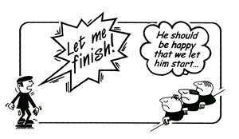
So what?
Sorry, you gotta listen to 1 story
Story of my old Music Theory column
Therefore the practical purpose of workshop
All .Net controls have events
All the Telerik controls have client and sever event models
You can customize behavior with these events by adding event handlers

Slide 25
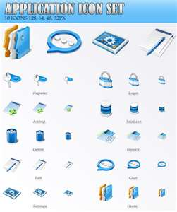
Now for Chris’ turn
The Online Application Event Model

Slide 26
Online Application
Single aspx page containing many dynamically-loaded ascx controls
ascx controls needed mechanism by which to respond to:
Containing page events (“Save and Next” and section header clicks)
Master application record changes
Other ascx control events (radio button selection changes, text changes, etc.)
Solution: Custom events
All ascx controls inherit from common base class which contains both event publishing and subscription code

Slide 27
Online Application
OLAControlHolder.ascx.cs
Events:
btnSectionHeader.Command
btnSaveAndNext.Command

Slide 28
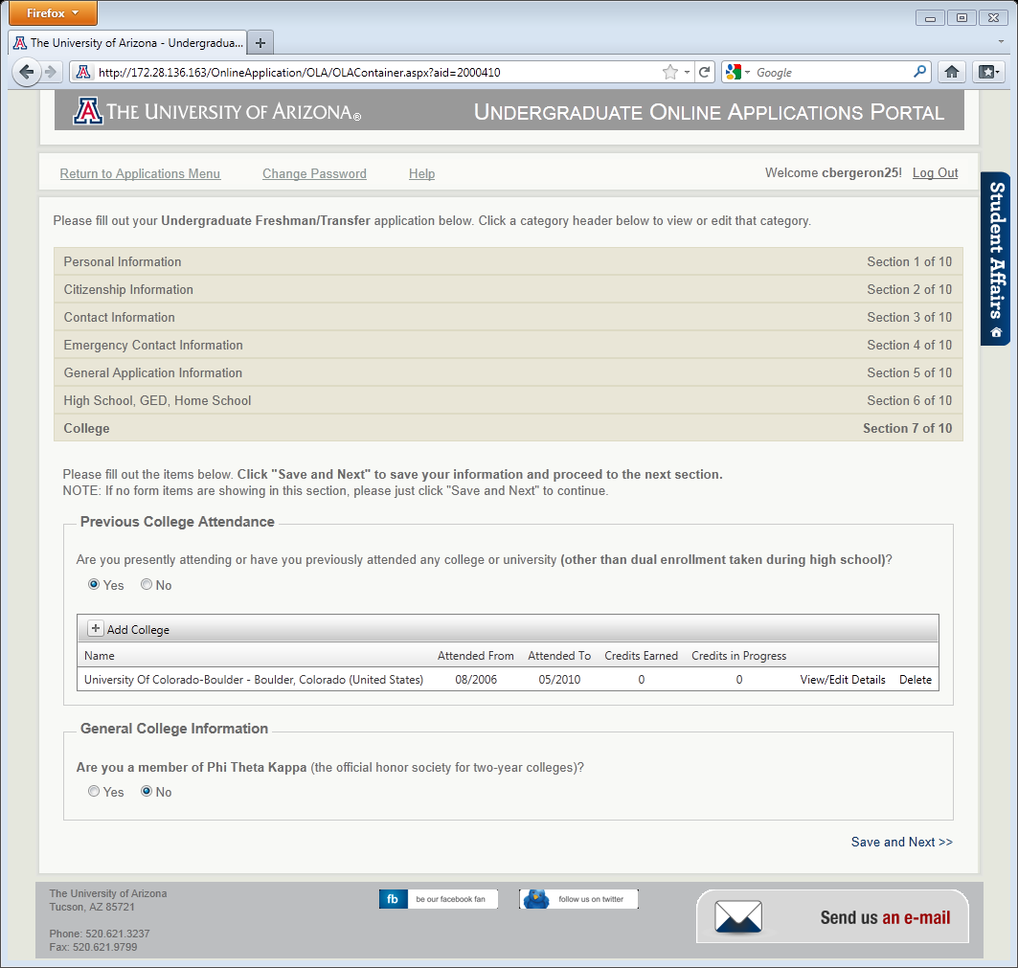
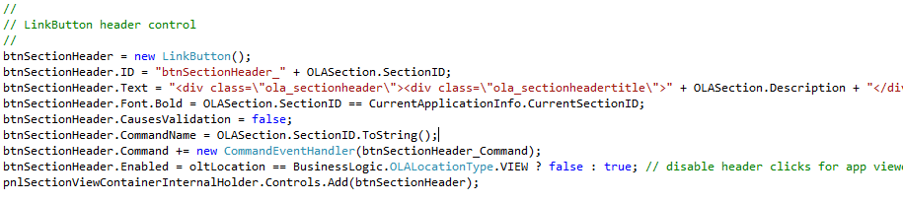
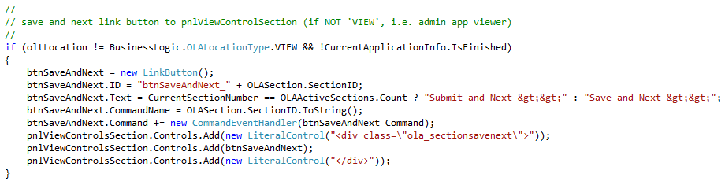
Online Application

Slide 29
Online Application
OLAViewUserControl.cs (view control base class)
Events published:
ControlContainer.GeneralAppInfoUpdated (with custom GeneralAppInfoUpdatedEventArgs.cs class)
Dynamic view control events: DependencyUserControl.ViewControlUpdated (with custom ViewControlUpdatedEventArgs.cs class)
Event subscriptions:
btnSectionHeader.Command
btnSaveAndNext.Command
ControlContainer.GeneralAppInfoUpdated
DependencyUserControl.ViewControlUpdated
Event subscription implementation available to all derived ascx controls through abstract event handlers

Slide 30
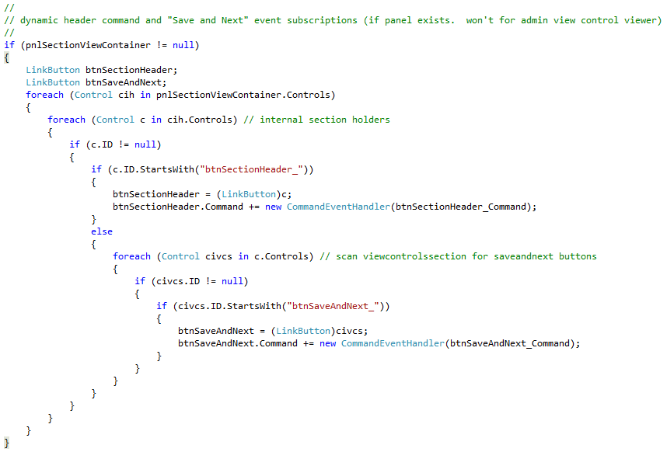
Online Application
btnSectionHeader and btnSaveAndNext Comands (sub)

Slide 31
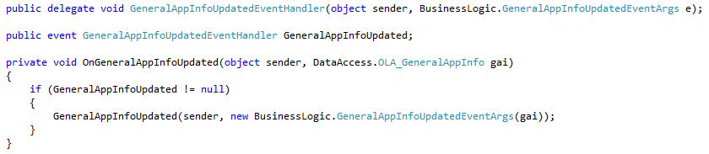
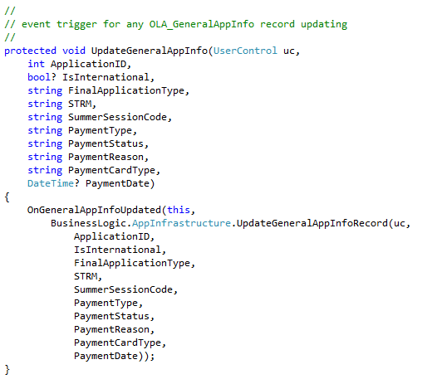
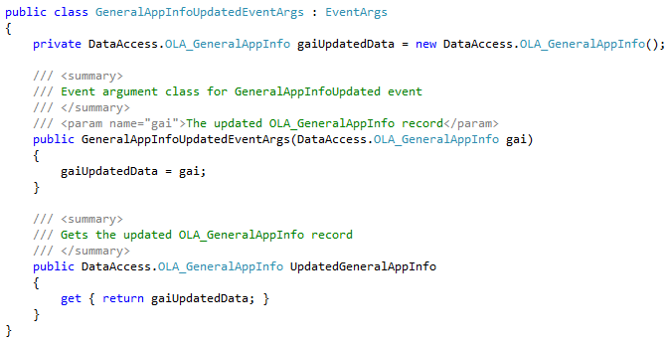
Online Application
ControlContainer.GeneralAppInfoUpdated (pub)

Slide 32
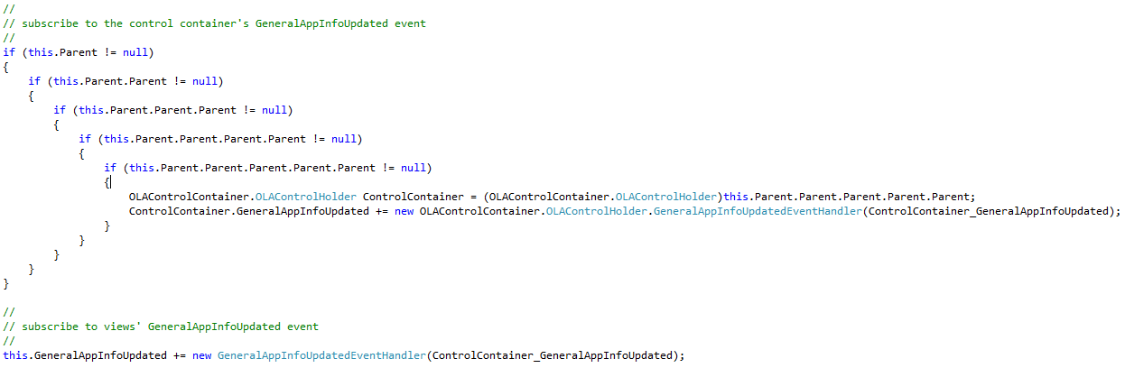
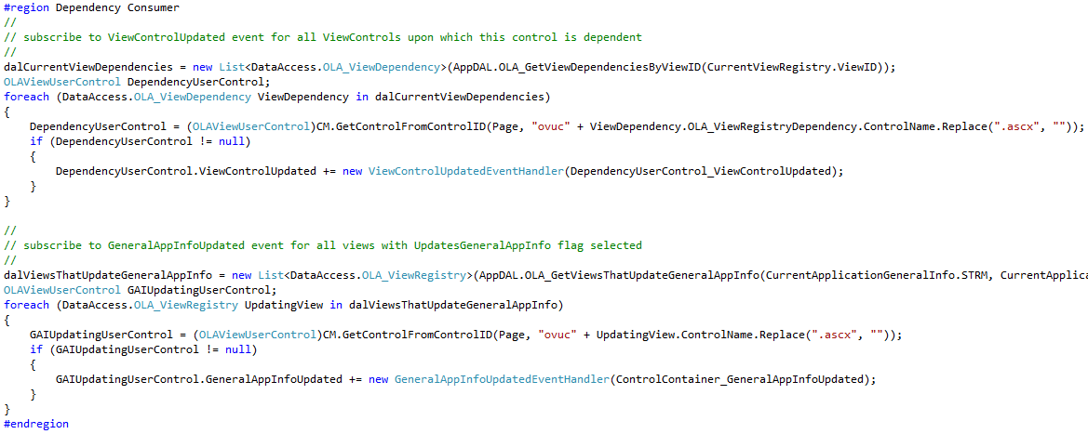
Online Application
ControlContainer.GeneralAppInfoUpdated (sub)

Slide 33
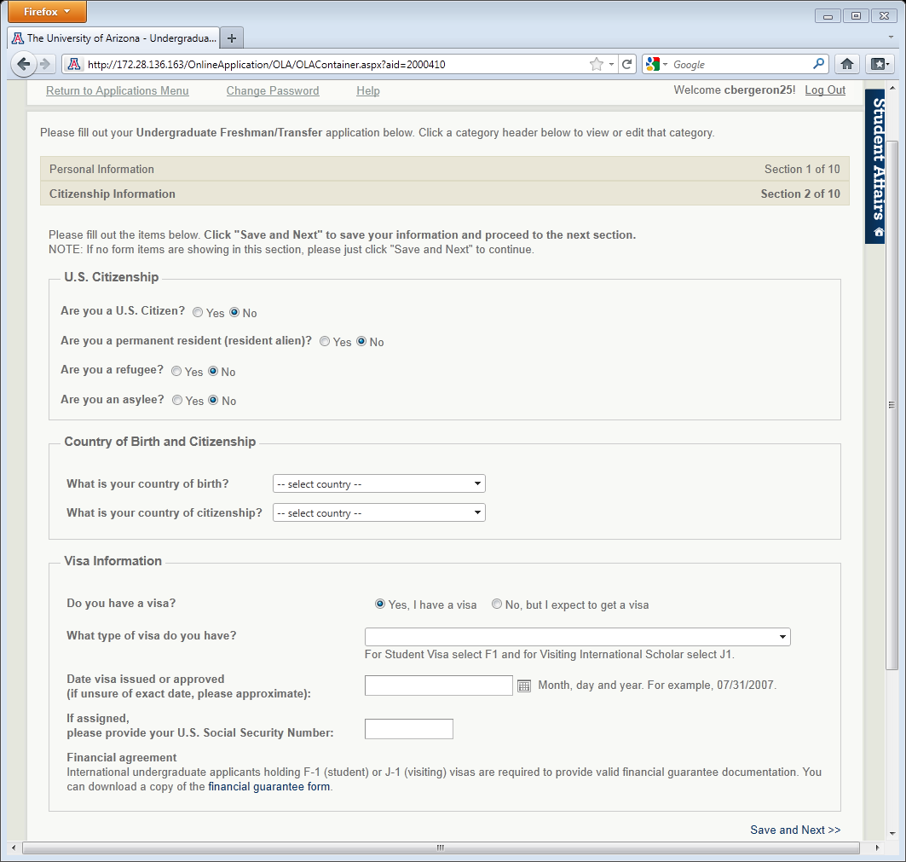
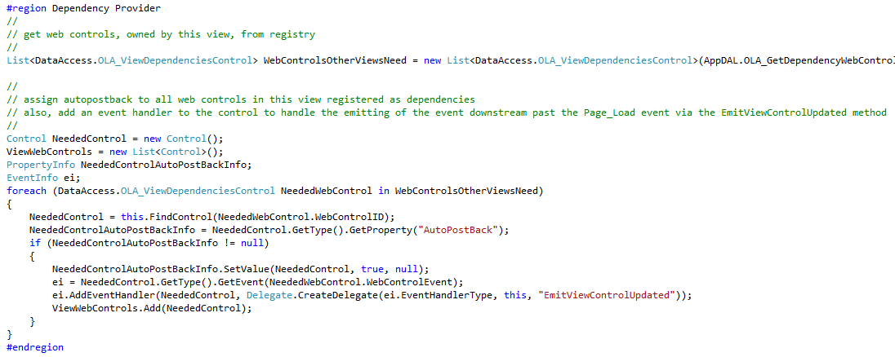
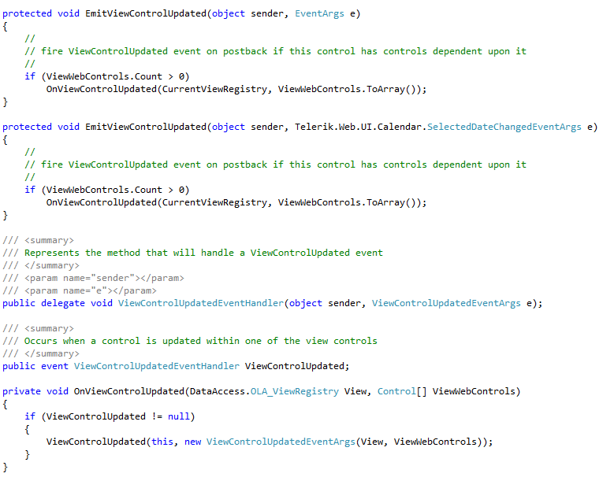
Online Application
DependencyUserControl.ViewControlUpdated (pub)

Slide 34
Online Application
DependencyUserControl.ViewControlUpdated (sub)

Slide 35
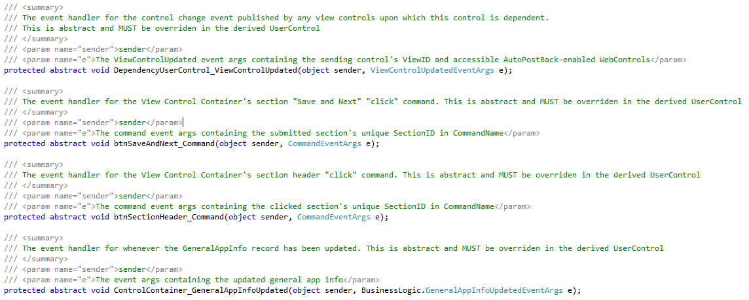
Online Application
Event handling implementation via abstract methods

Slide 36
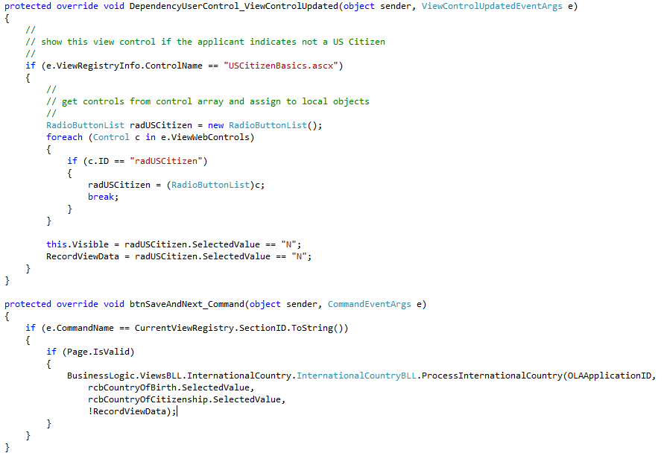
Online Application
Event handling implementation via abstract methods

Slide 37
Conclusion
Events are a great way (and sometimes the only way) to make one or more controls aware of another control’s state
It’s fun!
Oh yea and we have to add one thing for the boss

Slide 38
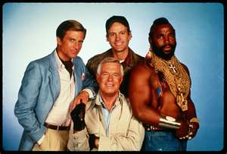
I pity the fool
This is <T>-Bird
He is the Mr. T of birds
In future workshops, he will accompany all slides with generics
He has no real purpose, just to amuse me
I love it when a plan comes together
What am I doing here Deb?
Chris
don-E

